Slide 1



Chatbots
Hello!
Why, hello.
By Ka Hung Lee

Slide 2
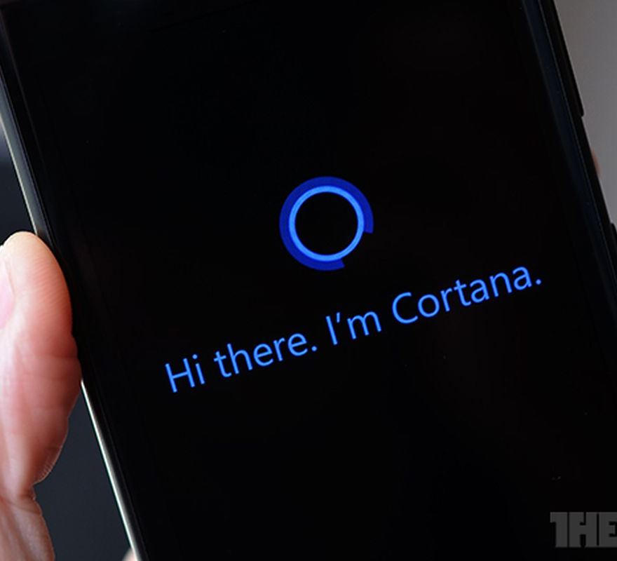
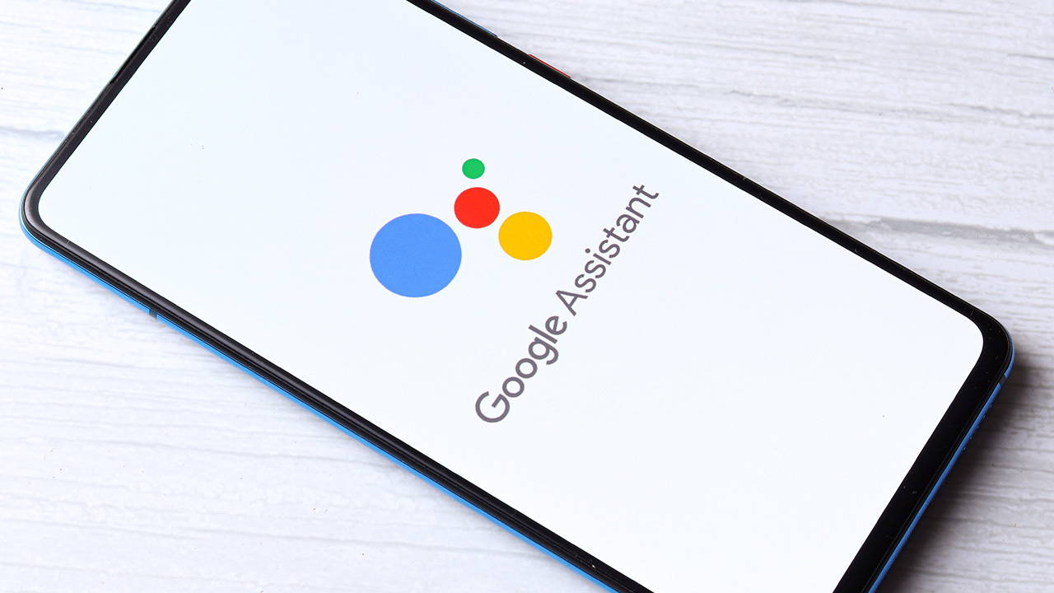
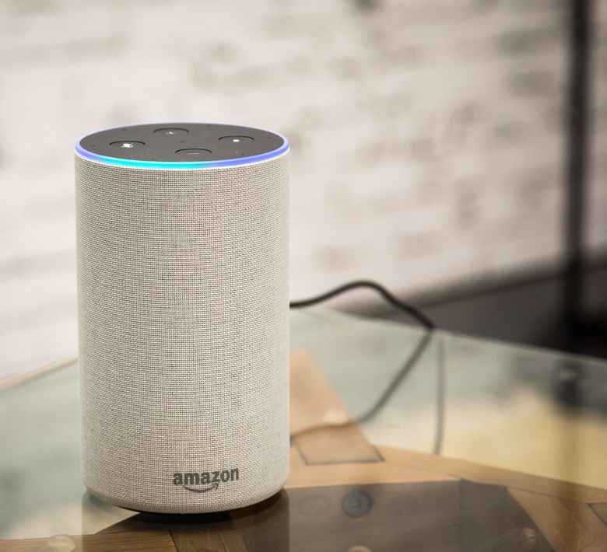
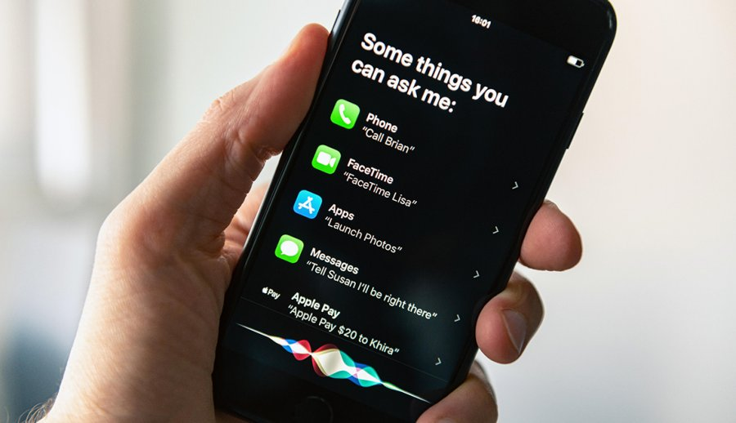
Motivation
Virtual assistants and chatbots attracted enormous attention over the past decade
However, most utilizes a “retrieval-based” approach
Instead, I want to build a “generative” chatbot that could generate new responses

Slide 3
Data
Cornell Movie Dialogues Corpus
Link: https://www.cs.cornell.edu/~cristian/Cornell_Movie-Dialogs_Corpus.html
220,579 conversational exchanges from 617 movies
304,713 utterances in total

Slide 4
Examples of Conversation
Person A: I figured you’d get to the good stuff eventually.
Person B: What good stuff?
Person A: The “real” you.
Person B: Like my fear of wearing pastels?
Person A: Hey, sweet cheeks
Person B: Hi Joey.
Person A: You're concentrating awfully hard considering it’s gym class.
Person A: Hey, since when do you play Thomas Edison? This looks like Sheila’s.
Person B: It is...was. It's a zapper, it might help me stay awake.
Person A: Yeah, or turn you into toast.

Slide 5
Method: Seq2Seq
[12, 4, 10, 1]
(Vectorized Reply)
Hi, how are you?
(Comment)
Decoder Input
Output
Input
Seq2Seq Model
I’m fine, thank you.
(Reply)
Encoder
Decoder
Input Sequence
Output Sequence
[23, 94, 19, 1]
I’m fine, thank you.
(Vectorized Comment)
(Predicted Reply)
The idea is to train Seq2Seq Model to predict output sequence from inputs

Slide 6
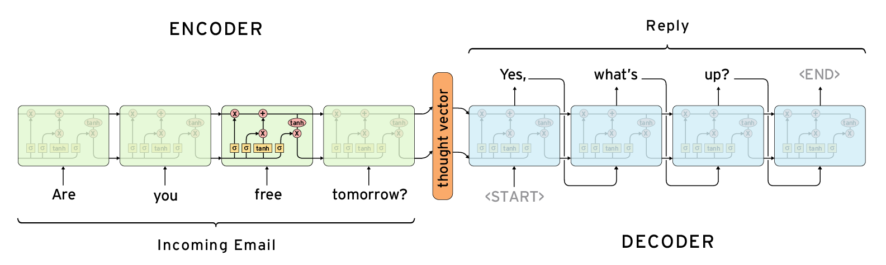

Models
LSTM Model
Source: https://suriyadeepan.github.io/2016-12-31-practical-seq2seq/
2 types of neural network architectures used for Seq2Seq models:
- RNNs/LSTMs
- Traditional approach to Seq2Seq problems
- Transformers
- New, but powerful approach to sequential problems (e.g. BERT, GPT-3)
Transformer Model
Source: http://jalammar.github.io/illustrated-transformer/

Slide 7
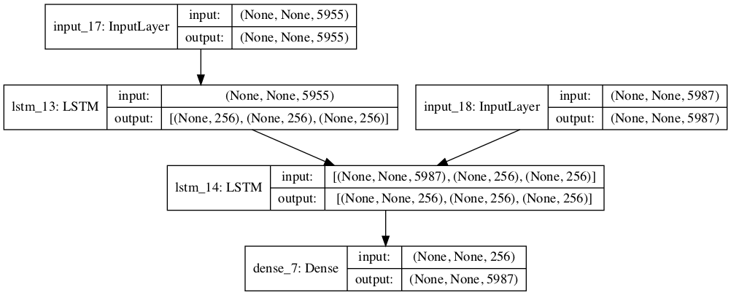
Our LSTM Model
Input Sequence
Decoder Input
Encoder
Decoder
14+ million trainable parameters
Output Sequence

Slide 8

Training
Only 6000 pairs were used
Training size: 5400
Validation size: 600
Even then, it takes 15 minutes per epoch!
Total training time over 2 days

Slide 9
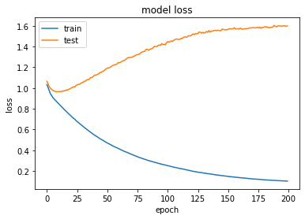
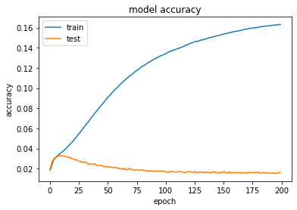
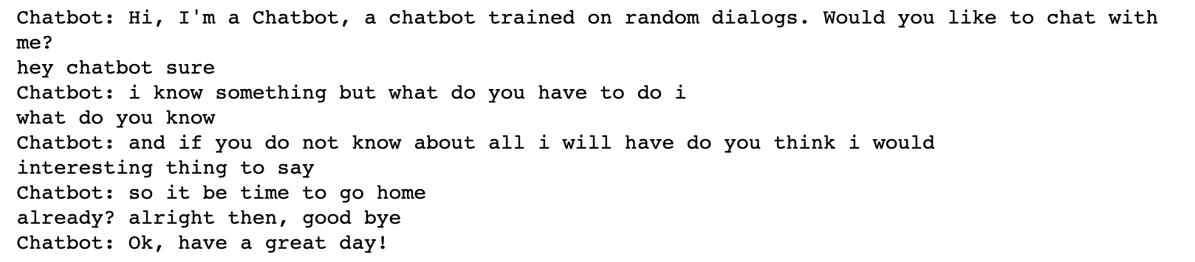
Results
Final accuracy: 16.32% (training), 1.60% (validation)
Final Loss: 0.10 (training), 1.60 (validation)
Overfitting is quite apparent
However, we did manage to make the chatbot “talk”

Slide 10
Conclusion
Chatbot could do better, perhaps with more data
Training neural networks could be quite expensive computationally

Slide 11
Future Direction
Increase training and validation sets (given enough computing power)
Try a different architecture (i.e. transformers)

